Slide 1
UNIT – FIVE
PART - THREE

Slide 2
Organisational culture is the system of shared beliefs and values that develops within an organisation and guides the behaviour of its members. Sometimes called the corporate culture, it is a key aspect of any organisation and work setting.

Slide 3
Strong cultures — ones that are clear and well defined and widely shared among members — discourage dysfunctional work behaviours and encourage positive ones. They commit members to do things for and with one another that are in the best interests of the organisation, and then they reinforce these habits.

Slide 4
stories — oral histories and tales, told and retold among members, about dramatic sagas and incidents in the life of the organisation
heroes — the people singled out for special attention and whose accomplishments are recognised with praise and admiration among members; they include founders and role models
rites and rituals — the ceremonies and meetings, planned and spontaneous, that celebrate important occasions and performance accomplishments
symbols — the special use of language and other non‐verbal expressions to communicate important themes of organisational life.

Slide 5
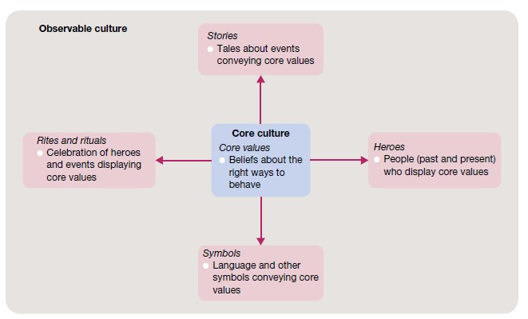
Levels of Organisational culture — observable culture and core culture

Slide 6
Leadership and organisational culture
This culture operates to support the group and its performance objectives will depend in part on the strength of the core values. At any level, these values should meet the test of three criteria:
relevance — core values should support key performance objectives;
pervasiveness — core values should be known by all members of the organisation or group; and
strength — core values should be accepted by everyone involved.

Slide 7
Symbols well to establish and maintain a desired organisational culture. Symbolic managers and leaders talk the ‘language’ of the organisation

Slide 8
Language metaphors — the use of positive examples from another context — are very powerful in this regard. Good symbolic leaders highlight the observable culture.

Slide 9
Ethics
Ethics can be defined as the code of moral principles that sets standards of good or bad, or right or wrong, in a person’s conduct and thereby guides the behaviour of that person or group.
ethical behaviour is that which is accepted to be ‘good’, ‘right’ and ‘proper’ as opposed to ‘bad’, ‘wrong’ or ‘improper’ in the context of the governing moral code.

Slide 10
The ethical question extends to personal values — the underlying beliefs and attitudes that help determine individual behaviour. Values vary among people.

Slide 11
Alternative views of ethical behaviour
utilitarian view. Behaviour that would be considered ethical from this perspective delivers the greatest good to the greatest number of people. Founded in the work of 19th century philosopher John Stuart Mill, this is a results oriented point of view that tries to assess the moral implications of decisions in terms of their consequences. Business decision makers, for example, are inclined to use profits, efficiency and other performance criteria to judge what is best for the most people.

Slide 12
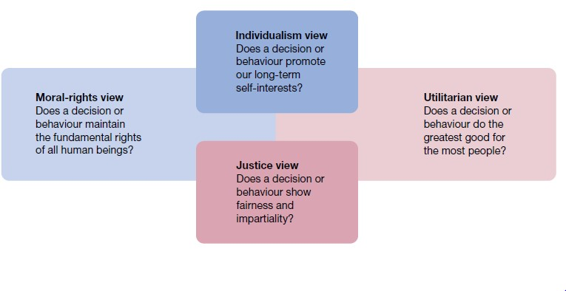
Four views of ethical Behaviour

Slide 13
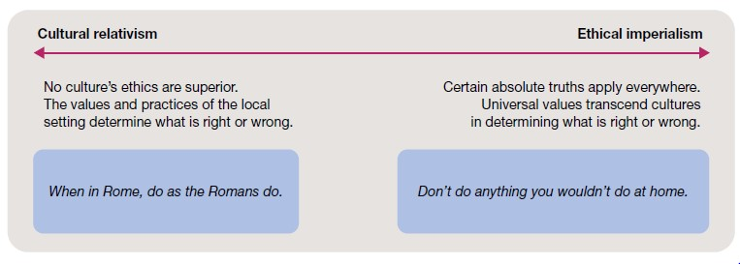
The extremes of cultural relativism and ethical imperialism

Slide 14
Ethical standards are universal and should apply absolutely across cultures and national boundaries. Critics of such a universal approach claim that it is a form of ethical imperialism, or the attempt to externally impose your ethical standards on others.

Slide 15
Ethical problems faced by managers
discrimination — where a manager denies promotion or appointment to a job candidate because of the candidate’s race, religion, gender, age or other criterion not relevant to the job
sexual harassment — where a manager makes a co‐worker feel uncomfortable because of inappropriate comments or actions regarding sexuality.
conflicts of interest — where a manager takes a bribe or kickback or extraordinary gift in return for making a decision favourable to the gift giver
customer confidence — where a manager has privileged information regarding the activities of a customer and shares that information with another party
organisational resources — where a manager uses official stationery or a company email account to communicate personal opinions or requests to community organisations.

Slide 16
There are at least four common rationalisations that are used to justify misconduct in these and other ethical dilemmas.
Convince yourself that the behaviour is not really illegal.
Convince yourself that the behaviour is really in everyone’s best interests.
Convince yourself that nobody will ever find out what you’ve done.
Convince yourself that the organisation will ‘protect’ you.

Slide 17
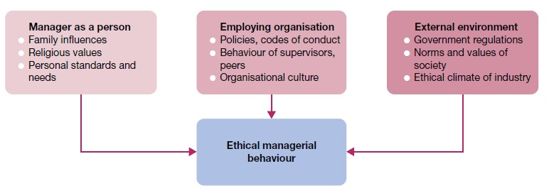
Factors influencing ethical managerial behaviour — the person, organisation

Slide 18
Maintaining high ethical standards
Progressive organisations support a variety of methods for maintaining high ethical standards in workplace affairs. Some of the most important efforts in this area involve ethics training, whistleblower protection, top management support, formal codes of ethics and strong ethical cultures.
Ethics training
Ethics training, in the form of structured programs to help participants understand the ethical aspects of decision‐making, is designed to help people incorporate high ethical standards into their daily behaviour.

Slide 19
Whistleblower protection
Whistleblowers, are people who expose the misdeeds of others in organisations in order to preserve ethical standards and protect against wasteful, harmful or illegal acts. Whistleblowers face the risks of impaired career progress and other forms of organisational retaliation, up to and including dismissal. Many workers become whistleblowers unintentionally when reporting workplace fraud, corruption or maladministration.

Slide 20
Some organisational barriers to whistleblowing include a strict chain of command that makes it hard to bypass the boss, strong work group identities that encourage loyalty and self‐censorship, and ambiguous priorities that make it hard to distinguish right from wrong.

Slide 21
Ethical role models
Top managers in large and small businesses have the power to shape their organisation’s policies and set its moral tone. They also have a major responsibility to use this power well. They can and should serve as role models of appropriate ethical behaviour for the entire organisation.

Slide 22
Codes of ethics
Formal codes of ethics are official written guidelines on how to behave in situations susceptible to the creation of ethical dilemmas. They are found in organisations and in professions such as engineering, medicine, law and public accounting.

Slide 23
A sample formal Code of Vendor Conduct, among the many areas covered, the document specifically deals with:
discrimination — stating ‘Factories shall employ workers on the basis of their ability to do the job, not on the basis of their personal characteristics or beliefs’
forced labour — stating ‘Factories shall not use any prison, indentured or forced labour’
working conditions — stating ‘Factories must treat all workers with respect and dignity and provide them with a safe and healthy environment’
freedom of association — stating ‘Factories must not interfere with workers who wish to lawfully and peacefully associate, organize or bargain collectively.

